Slide 1
Test Automation Framework Recommendations
QA Team Lead
Kevin McMahon
Notes:
This presentation compares three practical automation frameworks and explains when each one makes sense.
The goal is to support repeatable testing that fits real project constraints like release speed, team skills, and maintenance effort.
I will close with a simple recommendations based on common delivery patterns and risk areas.

Slide 2
What Test Automation Frameworks Do
Runs test steps automatically and compares actual results to expected results
Supports repeatable regression checks after code changes
Scales testing across many inputs and browsers when needed
Standardizes how tests are written, organized, executed, and reported
Reduces manual effort over time, but requires upfront setup and ongoing maintenance
Notes:
Test automation frameworks allow teams to run test steps automatically and compare the results against what is expected. This removes the need to manually repeat the same checks every time the software changes.
One of the biggest advantages is support for repeatable regression testing. When code is updated, automated tests quickly confirm that existing features still work as intended.
Automation also makes it possible to test many inputs and browser combinations that would be time consuming or unrealistic to cover by hand, especially in larger applications.
Frameworks help standardize how tests are written, organized, executed, and reported. This consistency improves collaboration across the team and makes test results easier to understand and trust.
While automation reduces manual effort over time, it does require upfront setup and ongoing maintenance. The long term value comes from focusing automation on high risk and frequently used functionality.

Slide 3

Recommendation 1: Playwright
Best fit: modern web apps that need reliable browser automation at speed
Strengths: strong stability, fast execution, good support for multiple browsers
Built in features: traces, screenshots, video capture, and test runner options
Works well for: user flows that must be validated every release
Watch outs: requires coding comfort and consistent test data management
Notes:
Playwright is a strong choice for modern web applications that rely heavily on browser based user interactions. It is designed to automate real user behavior at high speed while remaining stable across different browsers.
One of its biggest strengths is reliability. Playwright handles timing and page loading very well, which reduces flaky tests and makes results more trustworthy. This is especially helpful when validating critical user flows before each release.
It also includes useful built in features such as screenshots, video capture, and detailed execution traces. These features make it easier to diagnose failures without rerunning tests or adding extra tooling.
Playwright works particularly well when teams need to validate the same user journeys repeatedly, such as login flows, form submissions, or checkout paths.
The main consideration is that it does require comfort with coding and consistent test data management. Teams need to plan for clean data and disciplined test design to get the most value from it.

Slide 4
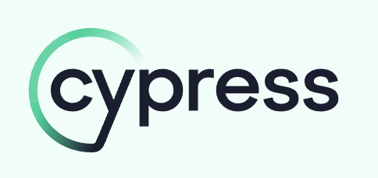
Recommendation 2: Cypress
Best fit: web app testing where developer feedback speed matters
Strengths: quick setup, strong debugging experience, clear test readability
Great for: front end regression checks on critical pages and flows
Works well with: teams that already use JavaScript for tooling
Watch outs: some environments and advanced browser coverage can add complexity
Notes:
Cypress is a strong option for teams focused on fast feedback during web application development. It is especially effective when developers want to see test results immediately while building or modifying features.
One of Cypress’s biggest advantages is it being developer friendly. Tests run directly in the browser, which makes debugging easier and faster. When something fails, developers can see exactly what happened at each step without digging through logs.
Cypress is better suited for front end regression testing, specifically for critical pages like dashboards, forms, or navigation flows. Its clear and readable test syntax also helps teams maintain tests over time.
This tool works best for teams that already rely on JavaScript for development. Because it aligns closely with front end workflows, it fits naturally into daily development routines.
A key consideration is that more complex environments or advanced browser coverage can add setup effort. Teams may need additional configuration as applications grow or testing needs expand.

Slide 5
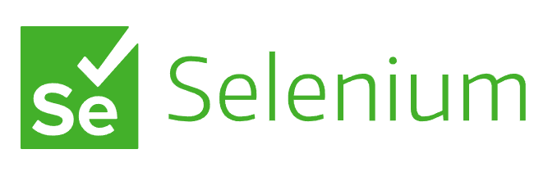
Recommendation 3: Selenium WebDriver
Best fit: broad compatibility needs and long term browser automation programs
Strengths: widely adopted, strong ecosystem, supports multiple languages
Great for: large regression suites and mixed tech stacks
Works well when: the team needs flexible integrations and established patterns
Watch outs: suites can become slow or brittle without good design and maintenance
Notes:
Selenium WebDriver is a long established automation framework that is widely used across many industries. It is often chosen when projects require wide variety of browser support and long term automation strategies.
One of Selenium’s strongest advantages is its flexibility. It supports multiple programming languages, which allows teams to integrate automation into existing technology stacks without forcing a single language choice. This makes it a practical option for larger or more complex environments.
Selenium works especially well for large regression test suites and systems that combine different technologies. It is commonly used in organizations that already have established testing patterns and need strong integration with other tools.
This framework is a good fit when teams require customization and control over how tests are designed and executed. It scales well when automation is treated as a long term investment rather than a quick setup.
A key consideration with Selenium is maintenance. Without clear structure and consistent upkeep, test suites can become slow or unreliable over time. Proper design and ongoing attention are critical to keeping Selenium tests effective.

Slide 6

How to Choose the Right Framework
If you need fast, reliable cross browser user flow testing: Playwright
1
If you want fast feedback for web UI changes: Cypress
2
If you need mature ecosystem and language flexibility: Selenium
3
Plan for maintenance: stable locators, reusable helpers, and clean test data
4
Start small: automate the highest risk workflows first, then expand coverage
5
Notes:
Choosing the right automation framework depends on what the team is trying to achieve and how the application is expected to evolve over time. There is no single best option that fits every project.
If the goal is fast and reliable cross browser testing of complete user workflows, Playwright is a strong choice. It is well suited for modern applications that need consistent validation across releases.
When rapid feedback is the priority, especially for frequent web interface changes, Cypress works well. Its tight feedback loop helps developers catch issues early during development.
Selenium is often the best fit when a project needs long term flexibility and broad language support. It is commonly used in larger environments where automation must integrate with existing tools and processes.
Regardless of the framework selected, planning for maintenance is critical. Stable locators, reusable helper functions, and clean test data management help keep automation reliable over time.
A practical approach is to start small by automating the highest risk workflows first. As confidence grows, test coverage can be expanded gradually without overwhelming the team.

Slide 7

Conclusion:
Top pick for most modern web projects: Playwright
Strong alternative when developer workflow and quick feedback is the focus: Cypress
Best choice for broad compatibility programs and established enterprise suites: Selenium
Automation works best when tied to CI checks and release readiness
Success depends on test design, maintenance discipline, and clear scope
Notes:
To wrap up, no automation framework is universally best, but each has a clear strength depending on the project context.
Playwright stands out as the strongest overall choice for most modern web applications because it offers fast execution, stable cross browser testing, and strong built in tools.
Cypress is a strong alternative when rapid developer feedback and ease of debugging are the primary concerns, especially during active feature development.
Selenium remains the best option for long term and enterprise environments where wide variety of language support and flexible integrations are absolutely necessary.
Automation is most effective when it supports continuous integration checks and release readiness rather than trying to replace all manual testing.
Ultimately, successful automation depends on careful test design, ongoing maintenance discipline, and a clearly defined test scope.

Slide 8

References
Cypress.io. (n.d.). Cypress documentation. https://docs.cypress.io/
JUnit Team. (n.d.). JUnit 5 user guide. https://junit.org/junit5/docs/current/user-guide/
Microsoft. (n.d.). Playwright documentation. https://playwright.dev/
Selenium. (n.d.). Selenium documentation. https://www.selenium.dev/
Wikipedia (n.d.). Test automation. https://en.wikipedia.org/wiki/Test_automation
Notes:
These references include official documentation for each recommended framework and one general background source on test automation.
All links are included so reviewers can verify features, supported environments, and usage guidance directly.

